Slide 1
CS 7180: Geometric Deep Learning
Lecture 9: Tensor Products, Clebsch-Gordon, Spherical Harmonics

Slide 2
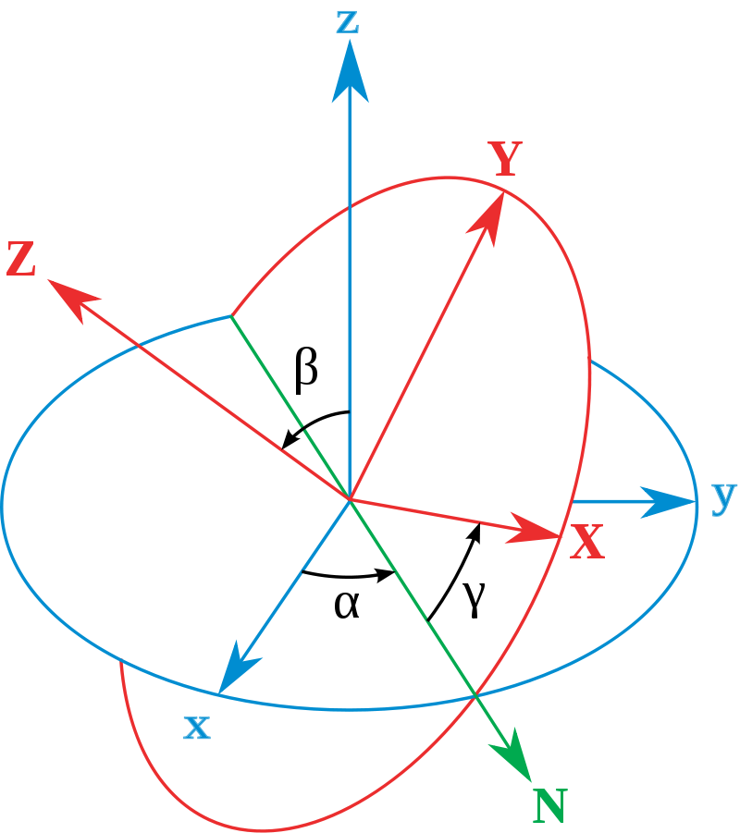

Slide 3
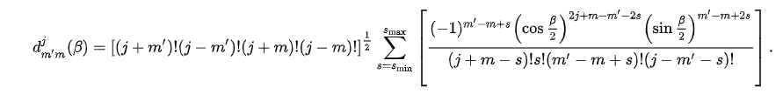
Wigner d-matrix

Slide 4
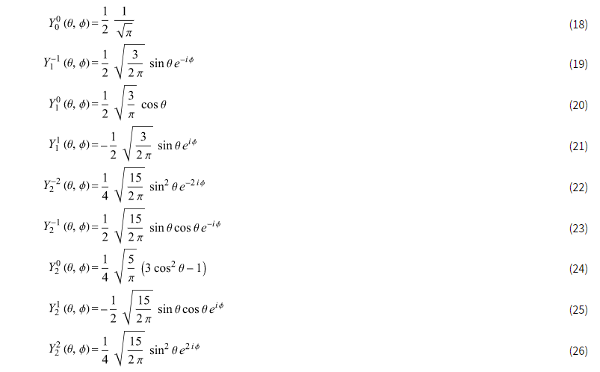

Slide 5
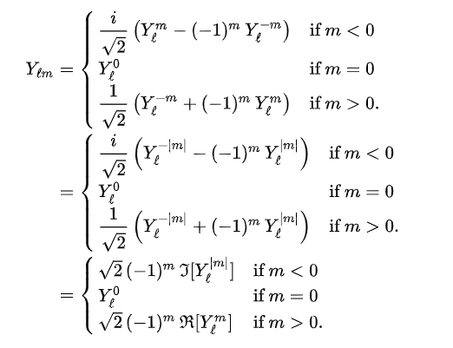
Spherical Harmonics Real Form

Slide 6
